Slide 1

National University of Computer and Emerging Sciences,
Islamabad, Pakistan
Training Multilayer Perceptron
CS-4025: Deep Learning for Perception

Slide 2
Goals
Review of Previous Lecture
Today’s Lecture
Multilayer Perceptron
Backpropagation for training Neural Networks

Slide 3
Recap of Previous Lecture

Slide 4
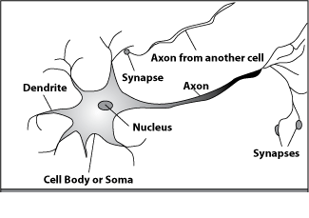
How do our brains work?
A processing element
Dendrites: Input
Cell body: Processor
Synaptic: Link
Axon: Output

Slide 5
An Artificial Neuron
y₁
w_{1j}
y₂
w_{2j}
w_{3j}
f(x)
O
y₃
y_{i}
w_{ij}
Each neuron has weighted input connections from each of the units in the preceding layer.
The unit performs a weighted sum of its inputs, to give its activation level.
Activation level is passed through a sigmoid activation function to determine output.

Slide 6
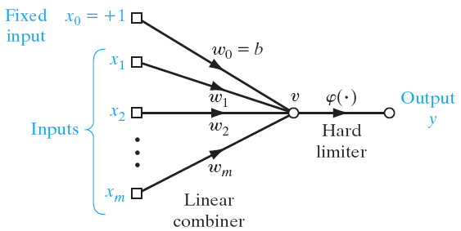
Rosenblatt's perceptron model

Slide 7
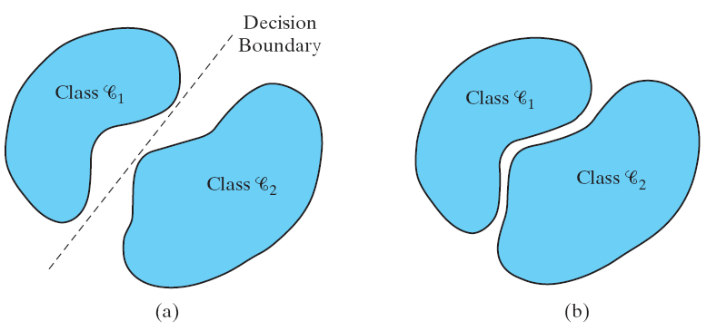
Rosenblatt's perceptron model

Slide 8
Today’s Lecture

Slide 9
ANN: Multi-Layer Perceptron
Need a complex model to understand complex patterns, such as object detection, face recognition, etc.
Most commonly used architecture is known as the multilayer perceptron.
Basic features of MLP
A differentiable nonlinear activation function
One or more hidden layers
High degree of connectivity (fully connected)

Slide 10
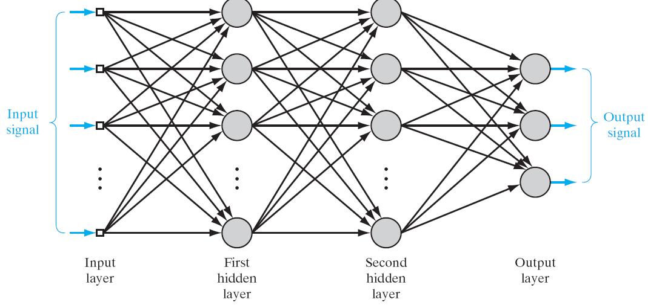
Artificial Neural Network

Slide 11
Artificial Neural Network
A popular method for the training of multilayer perceptron is the back-propagation algorithm (Generalized Delta Rule)
Forward phase:
The input data is propagated through the network, layer by layer, until it reaches the output.
Backward phase:
An error is calculated by comparing the output of the network with a desired response.
This error is propagated through the network in backward direction.

Slide 12
Neural Network
Network architecture or topology plays an important role for neural net classification.
Optimal topology for the problem at hand.
Empirically find the network architectures
The number of hidden layers, units, feedback connections, and so on.
Selecting models (network topologies) and estimating parameters (training via backpropagation) enable you to try out alternate models.

Slide 13
Neural Network
Adjustments must be made to the weights of the network.
Calculation of the adjustments for the output layer is straightforward
It is more challenging for the hidden layers.

Slide 14
Neural Network
Hidden Neurons
The hidden neurons act as feature detectors
The hidden neurons gradually “discover” the main features to understand the training data.
They perform nonlinear transformations on the input
Feature space.
Classes may be more easily separated from each other

Slide 15
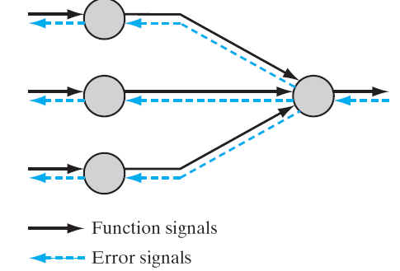
Neural Network

Slide 16
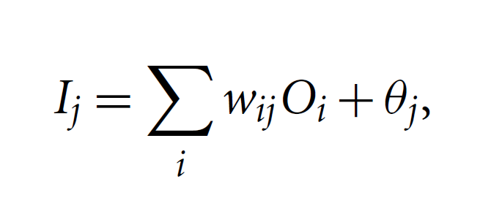
Input of Unit J
wij is the weight of the connection from unit I in the previous layer to unit j
Oi is the output of unit i from the previous layer
j is the bias of the unit

Slide 17
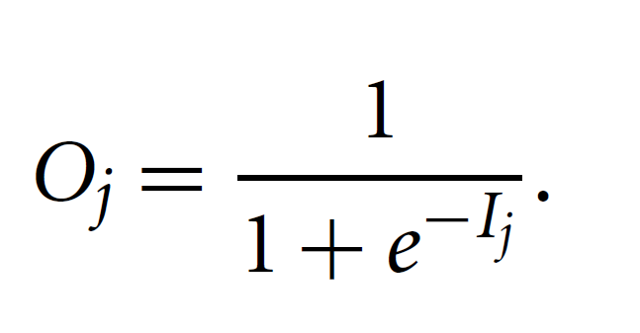
Output of Unit J

Slide 18
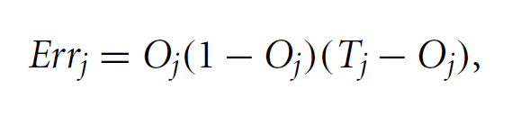
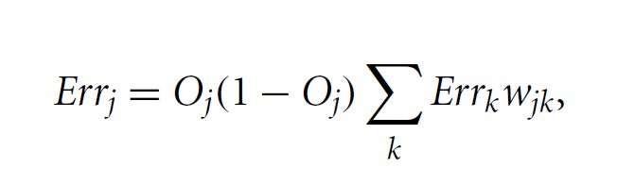
Back propagation of Error
For the Output layer:
For the Hidden layers:

Slide 19
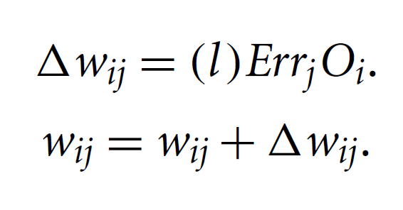
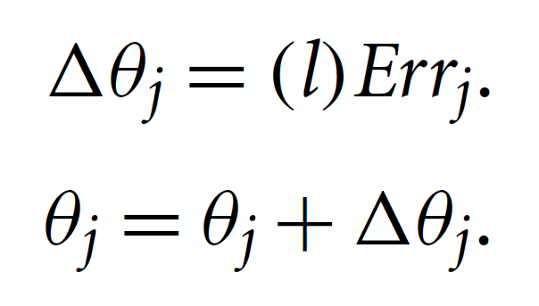
Update Weights and Bias
Update Weights:
Update Bias:

Slide 20
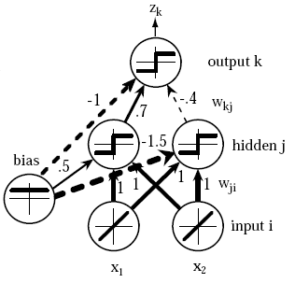
Neural Network

Slide 21
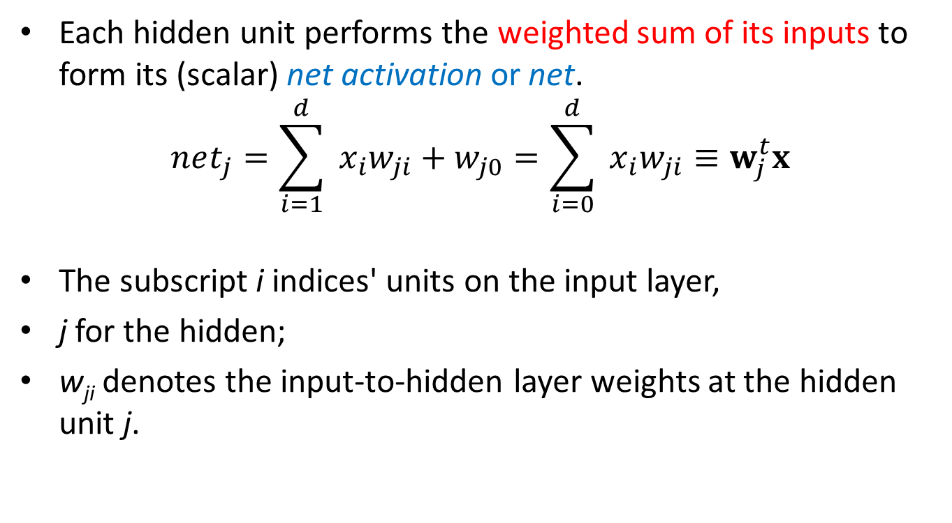
Neural Network
Each hidden unit performs the weighted sum of its inputs to form its (scalar) net activation or net.
$$net_{j}=\sum_{i=1}^{d}{ }x_{i}w_{ji}+w_{j0}=\sum_{i=0}^{d}{ }x_{i}w_{ji}≡w_{j}^{t}x$$
The subscript i indices' units on the input layer,
j for the hidden;
w_{ji} denotes the input-to-hidden layer weights at the hidden unit j.

Slide 22
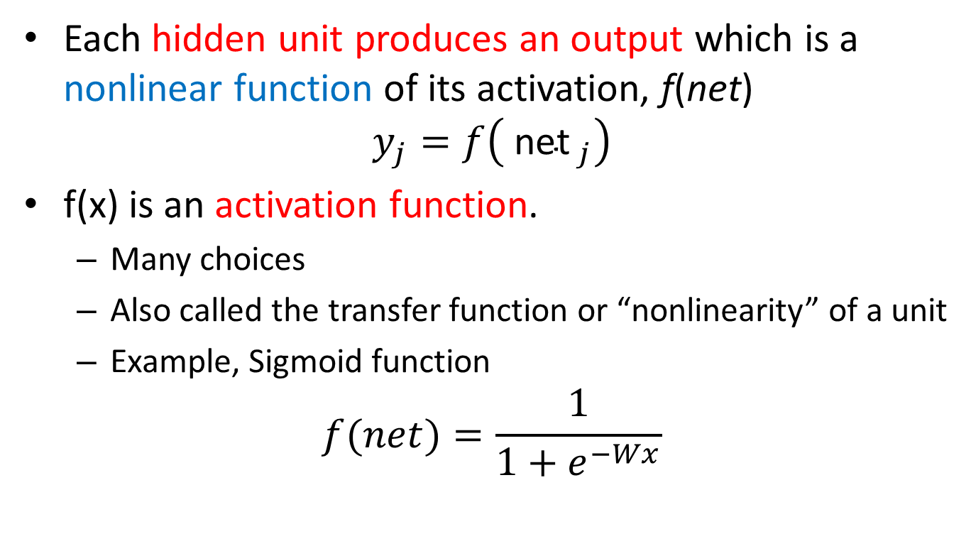
Neural Network
Each hidden unit produces an output which is a nonlinear function of its activation, f(net)
$$y_{j}=f\left({ \text{net} }_{j}\right)$$
f(x) is an activation function.
Many choices
Also called the transfer function or “nonlinearity” of a unit
Example, Sigmoid function
$$f(net)=\frac{1}{1+e^{−Wx}}$$

Slide 23
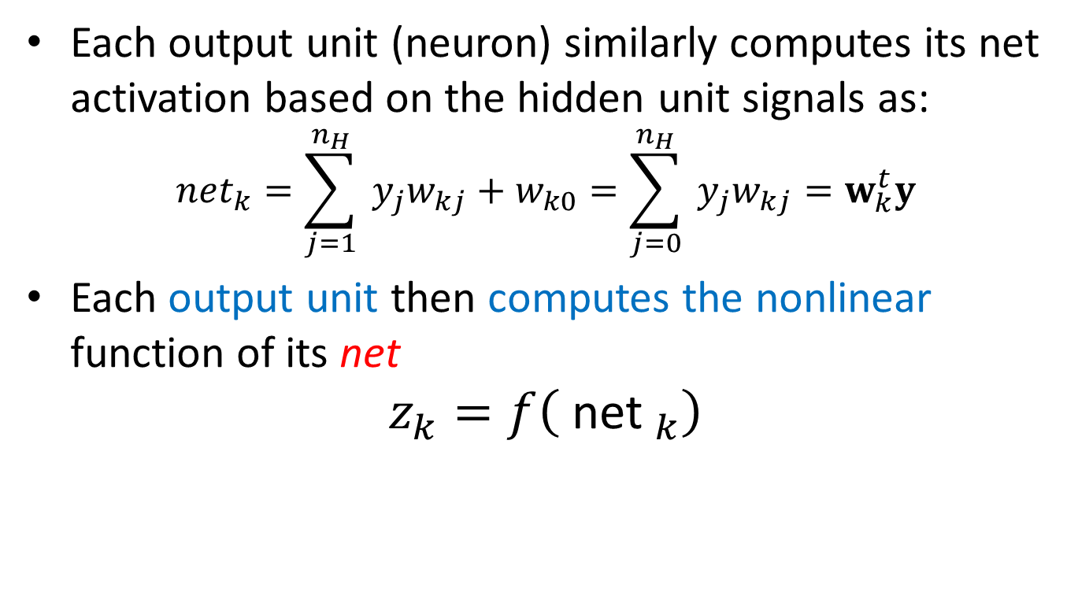
Neural Network
Each output unit (neuron) similarly computes its net activation based on the hidden unit signals as:
$$net_{k}=\sum_{j=1}^{n_{H}}{ }y_{j}w_{kj}+w_{k0}=\sum_{j=0}^{n_{H}}{ }y_{j}w_{kj}=w_{k}^{t}y$$
Each output unit then computes the nonlinear function of its net
$$z_{k}=f\left({ \text{net} }_{k}\right)$$

Slide 24
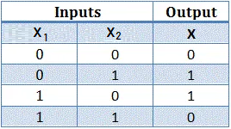
Neural Network

Slide 25
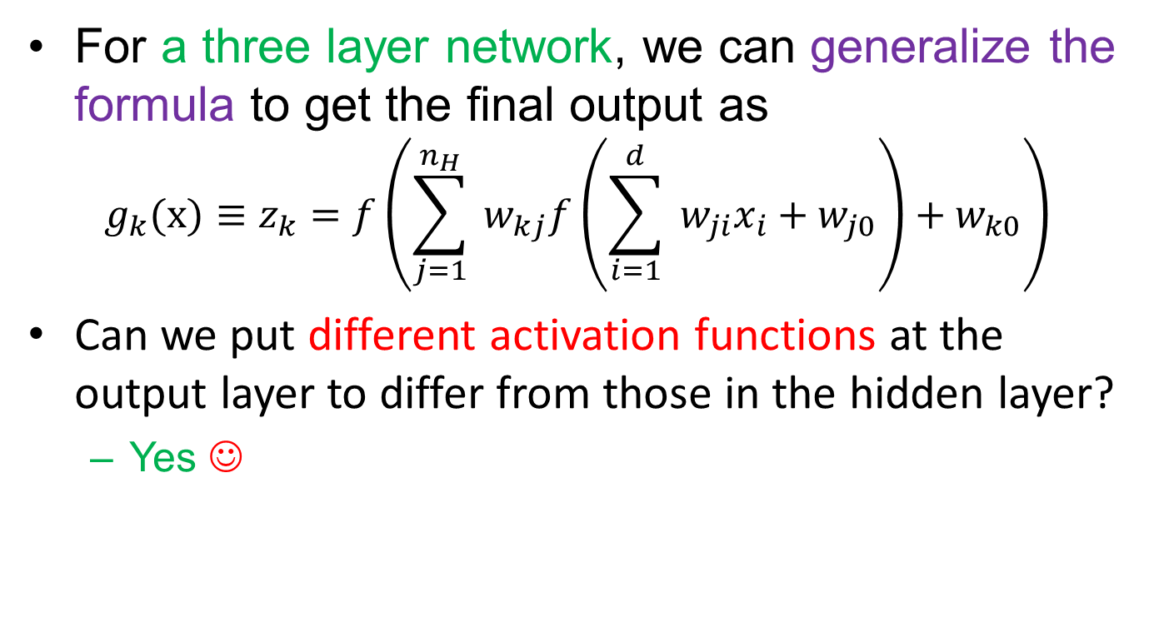
Neural Network
For a three layer network, we can generalize the formula to get the final output as
$$g_{k}(x)≡z_{k}=f\left(\sum_{j=1}^{n_{H}}{ }w_{kj}f\left(\sum_{i=1}^{d}{ }w_{ji}x_{i}+w_{j0}\right)+w_{k0}\right)$$
Can we put different activation functions at the output layer to differ from those in the hidden layer?
Yes ☺

Slide 26
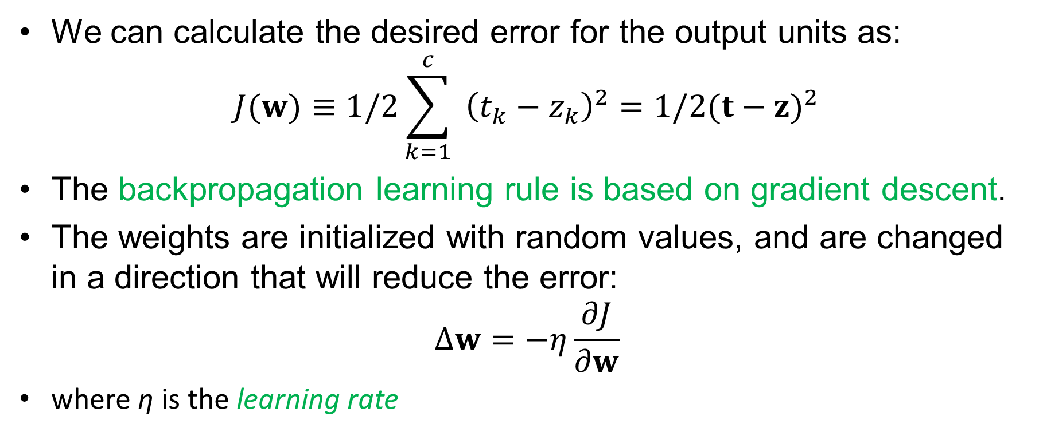
Backpropagation algorithm
We can calculate the desired error for the output units as:
$$J(w)≡1/2\sum_{k=1}^{c}{ }{\left(t_{k}−z_{k}\right)}^{2}=1/2(t−z)^{2}$$
The backpropagation learning rule is based on gradient descent.
The weights are initialized with random values, and are changed in a direction that will reduce the error:
$$Δw=−η\frac{∂J}{∂w}$$
where η is the learning rate

Slide 27
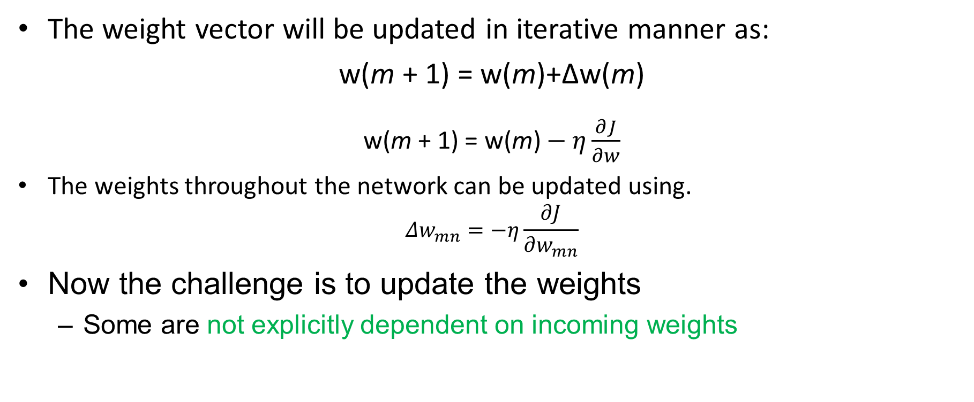
Backpropagation algorithm
The weight vector will be updated in iterative manner as:
w(m + 1) = w(m)+Δw(m)
w(m + 1) = w(m) $− η\frac{∂J}{∂w}$
The weights throughout the network can be updated using.
$$Δw_{mn}=−η\frac{∂J}{∂w_{mn}}$$
Now the challenge is to update the weights
Some are not explicitly dependent on incoming weights

Slide 28
Backpropagation algorithm
Consider first the hidden-to-output weights, w_{jk}.
we must use the chain rule for differentiation:
$$\frac{∂J}{∂w_{kj}}=\frac{∂J}{∂net_{k}}\frac{∂net_{k}}{∂w_{kj}}=δ_{k}\frac{∂net_{k}}{∂w_{kj}}$$
Sensitivity of output unit k is defined to be
$$δ_{k}≡−∂J/∂net_{k}$$

Slide 29
Backpropagation algorithm
The learning rule for the input-to-hidden units can be calculated as:
$$\frac{∂J}{∂w_{ji}}=\frac{∂J}{∂y_{j}}\frac{∂y_{j}}{∂net_{j}}\frac{∂net_{j}}{∂w_{ji}}$$

Slide 30
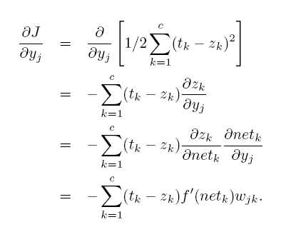
Backpropagation algorithm
This last equation expresses how the hidden unit output, yj , affects the error at each output unit.

Slide 31

Backpropagation algorithm
Similar to the sensitivity we calculated for the output units, we can also calculate the sensitivity for hidden units similar to previous equation as:
This equation indicates that the sensitivity at a hidden unit is simply the sum of the individual sensitivities at the output units weighted by the hidden-to-output weights w_{jk}, all multiplied by f(net_{j} ).

Slide 32
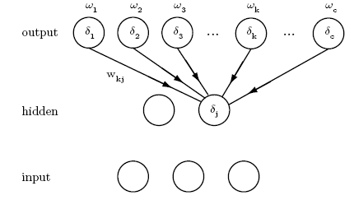
Backpropagation algorithm
The sensitivity at a hidden unit is proportional to the weighted sum of the sensitivities at the output units.
The output unit sensitivities are thus propagated “back” to the hidden units.

Slide 33
Backpropagation algorithm
Thus the learning rule for the input-to-hidden weights is:
$$Δw_{ji}=ηx_{i}δ_{j}=ηx_{i}f^{′}\left({ \text{net} }_{j}\right)\sum_{k=1}^{c}{ }w_{kj}δ_{k}$$
The “backpropagation of errors” (sensitivities δk) must be propagated from the output layer back to the hidden layer in order to perform the learning of the input-to-hidden weights.
It is just performing a gradient descent in each layer with chain rule to update the model parameters (weights).

Slide 34

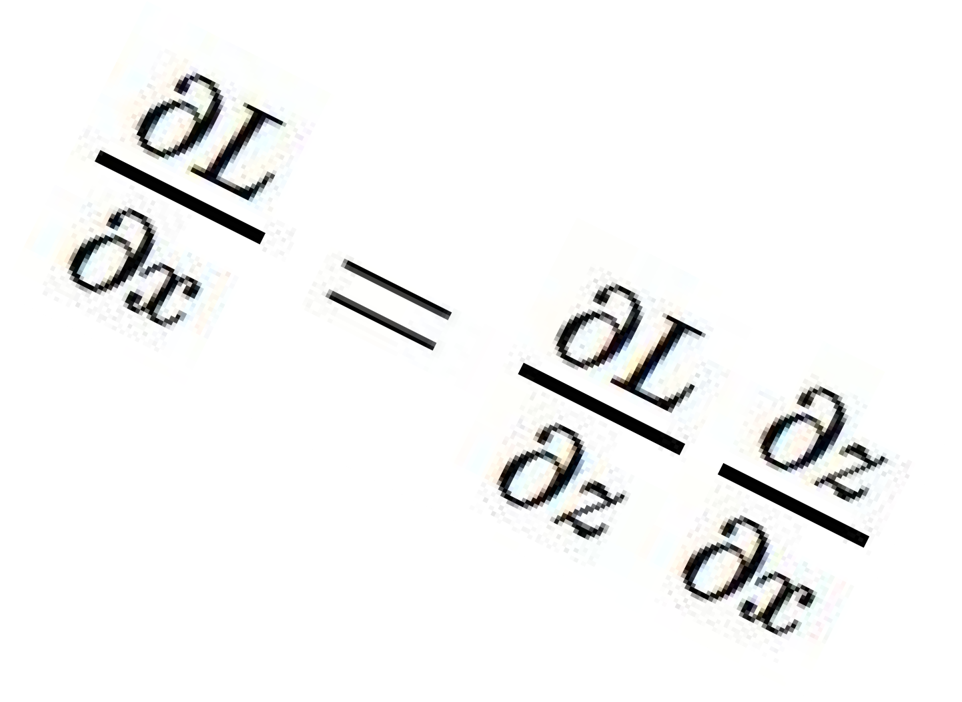




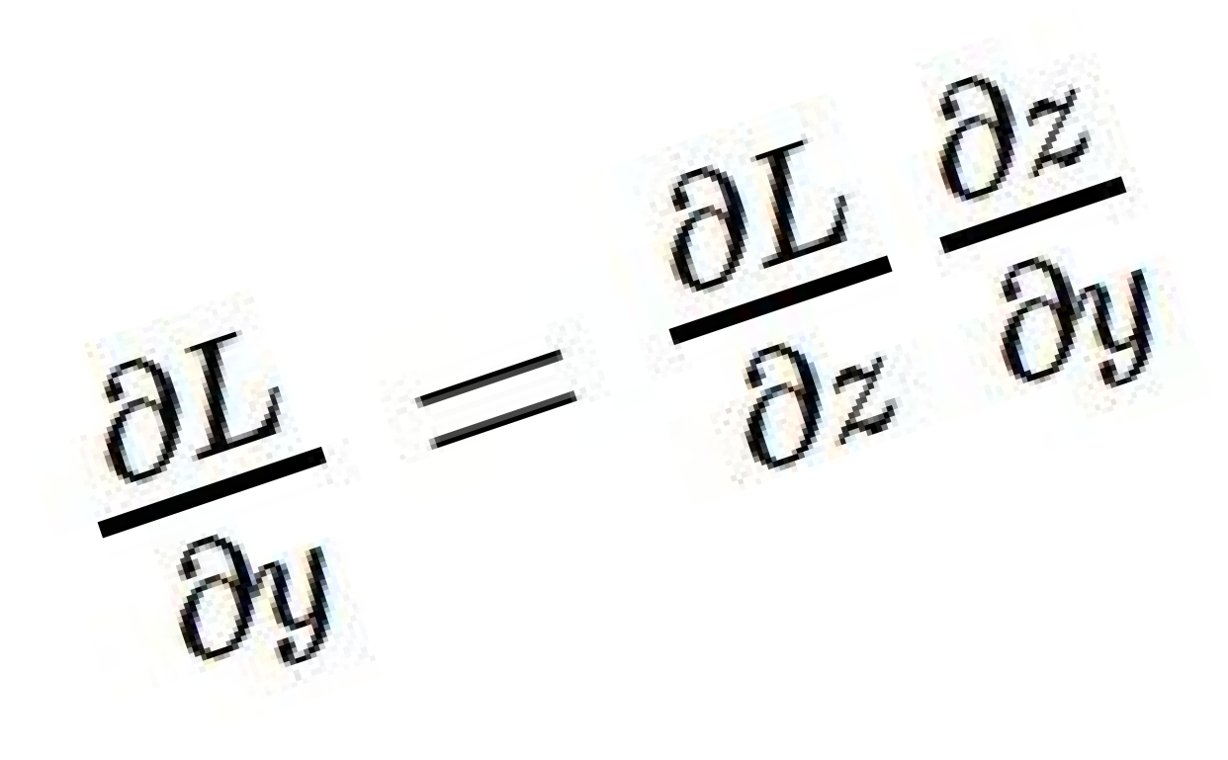
activations
“local gradient”
f
gradients

Slide 35
Chain Rule
Given:
Chain Rule:
y₁
u₁
u₂
…
u_{J}
x₂

Slide 36
Chain Rule
Given:
Chain Rule:
y₁
Backpropagation is just repeated application of the chain rule from Calculus.
u₁
u₂
…
u_{J}
x₂

Slide 37
Neural Network
y
Output
a₁
a₂
…
a_{D}
Hidden Layer
x₁
x₂
x₃
…
x_{M}
Input
Notes:
TODO: Include the math on the right.
TODO: Show the parameters.

Slide 38
Neural Network
Output
y
Hidden Layer
z₁
z₂
…
z_{D}
Input
x₁
x₂
x₃
…
x_{M}

Slide 39
Building a Neural Net
y
Output
a₁
a₂
…
a_{D}
Hidden Layer
D = M
1
1
1
x₁
x₂
…
x_{M}
Input
Notes:
What if we connect all the X to all the Z?

Slide 40
Building a Neural Net
y
Output
a₁
a₂
…
a_{D}
Hidden Layer
D = M
x₁
x₂
…
x_{M}
Input
Notes:
What if we connect all the X to all the Z?

Slide 41
Building a Neural Net
y
Output
a₁
a₂
…
a_{D}
Hidden Layer
D = M
x₁
x₂
…
x_{M}
Input
Notes:
What if we connect all the X to all the Z?

Slide 42
Building a Neural Net
y
Output
a₁
a₂
…
a_{D}
Hidden Layer
D < M
x₁
x₂
x₃
…
x_{M}
Input
Notes:
What if we connect all the X to all the Z?

Slide 43
Building a Neural Net
y
Output
x₁
x₂
…
x_{M}
Features
Notes:
This is regular perceptron

Slide 44
Decision Boundary
0 hidden layers: linear classifier
Hyperplanes

Slide 45
Decision Boundary
1 hidden layer
Boundary of convex region (open or closed)
Notes:
We saw with XOR

Slide 46
Decision Boundary
2 hidden layers
Combinations of convex regions

Slide 47
Multi-Class Output
y₁
…
y_{K}
Output
a₁
a₂
…
a_{D}
Hidden Layer
x₁
x₂
x₃
…
x_{M}
Input
Notes:
Why called feed forward?

Slide 48
Multi-Class Output
y₁
…
y_{K}
Output
a₁
a₂
…
a_{D}
Hidden Layer
x₁
x₂
x₃
…
x_{M}
Input
Notes:
Why called feed forward?

Slide 49
Deeper Networks
Output
y
Hidden Layer 1
a₁
a₂
…
a_{D}
Input
x₁
x₂
x₃
…
x_{M}

Slide 50
Deeper Networks
Output
y
Hidden Layer 2
b₁
b₂
…
b_{E}
Hidden Layer 1
a₁
a₂
…
a_{D}
Input
x₁
x₂
x₃
…
x_{M}

Slide 51
Deeper Networks
Output
y
Hidden Layer 3
c₁
c₂
…
c_{F}
Hidden Layer 2
b₁
b₂
…
b_{E}
Hidden Layer 1
a₁
a₂
…
a_{D}
Input
x₁
x₂
x₃
…
x_{M}

Slide 52
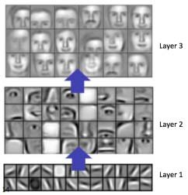
Deeper Networks

Slide 53
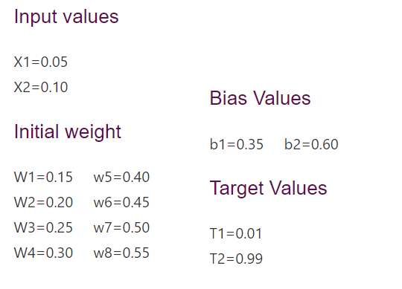
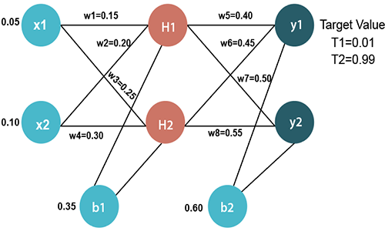
Example

Slide 54
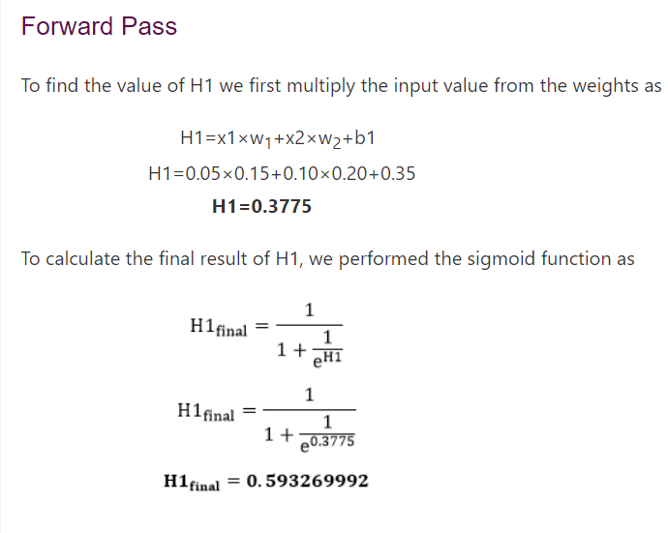

Slide 55
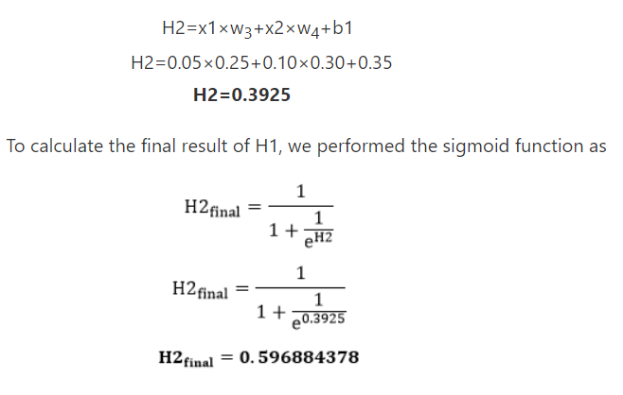

Slide 56
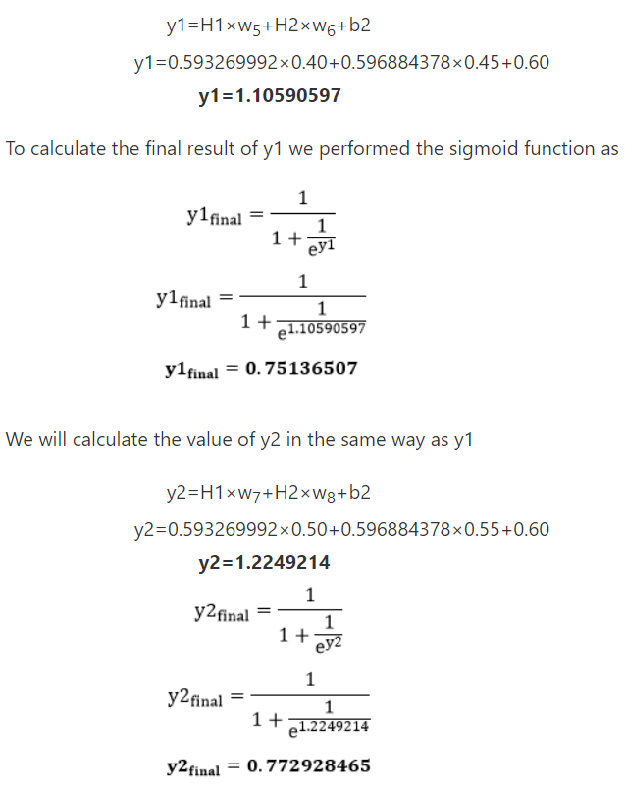

Slide 57
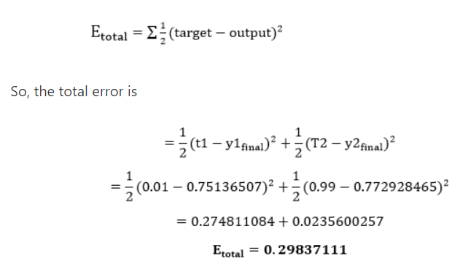
Example

Slide 58
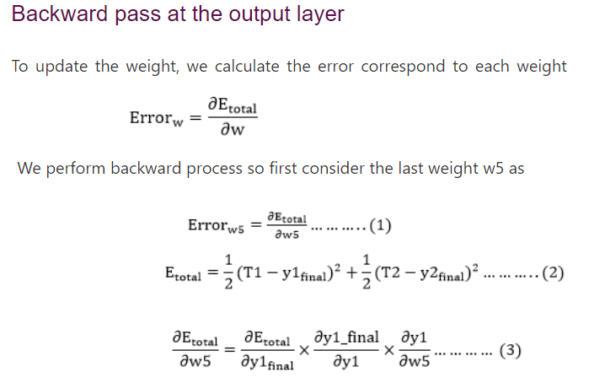
Example

Slide 59
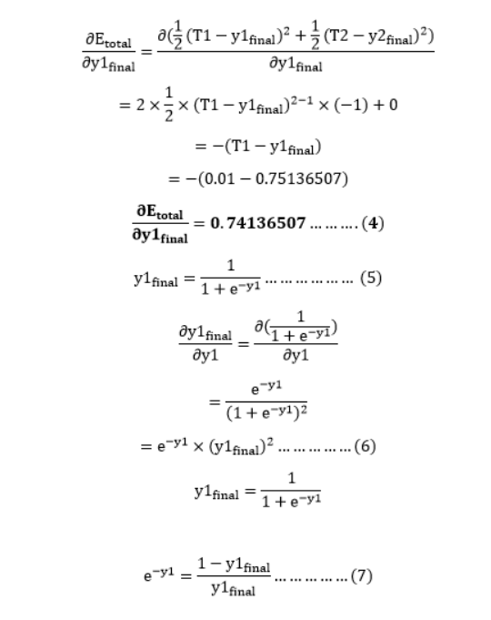

Slide 60
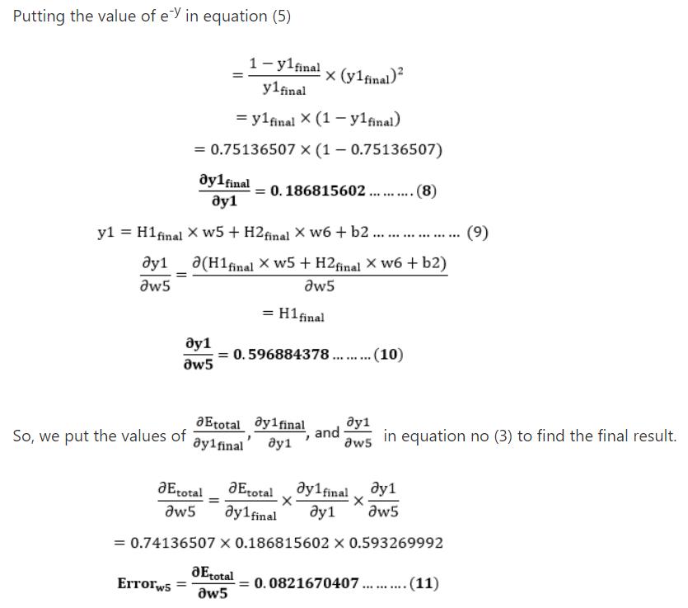

Slide 61
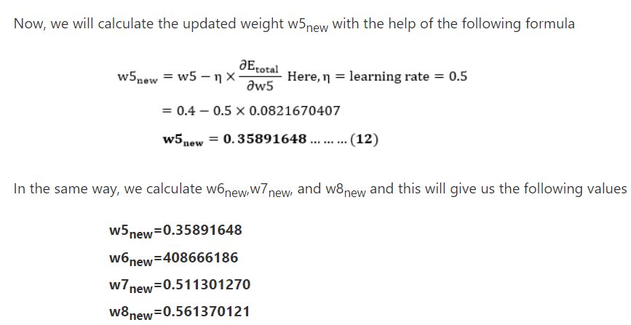
Example

Slide 62
Backpropagation
Steps
Initialize weights to small random numbers, associated with biases
Propagate the inputs forward (by applying activation function)
Backpropagate the error (by updating weights and biases)
Terminating condition (when error is very small, etc.)

Slide 63
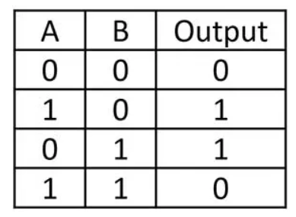
XOR using MLP
B1= 0
Input
1
H1
B3= 0
X1
X2
1
1
y
1
h₂₁
1
H2
-2
Output
B2= -1

Slide 64
References
Chapter 5, Deep learning book by MIT
Chapter 4, Neural Networks and Learning Machines, Haykin
Chapter 5, Pattern Recognition and Machine Learning, Bishop

Slide 65
Code
https://colab.research.google.com/github/rabbanyk/comp551-notebooks/blob/master/MLP.ipynb

Slide 66
Thank You ☺

